Slide 1
UNIT 1
Introduction to Python
Prof. Sheekha Raina Assistant Professor
AI&ML Department

Slide 2
Content
Introduction…………………………………………4
2. History and features of Python……….…….7
3. Installation and execution environment.26
4. Python syntax and semantics……………...27
5. Variables, identifiers, keywords…………..36 6. Input/output functions and Type conversions …………………..……………………….40
7. Data types ……….………………………...........43
8. Operators and expressions………………....69

Slide 3
Introduction
Python is a widely used programming language developed by Guido van Rossum and first released in 1991.
It is commonly applied in areas such as:
Web development (server-side)
Software development
Mathematical computing
System scripting
Web Development (Server-side): Python is used to build the backend of websites and web applications. Frameworks like Django and Flask help developers handle tasks such as database management, user authentication, and server logic efficiently.

Slide 4
Introduction
Software Development: Python is used to create desktop and standalone software applications. It supports rapid development and testing, making it suitable for building reliable and scalable software solutions.
Mathematical Computing: Python is widely used for mathematical calculations, data analysis, and scientific research. Libraries such as NumPy, Pandas, and SciPy help perform complex mathematical operations and data processing.
System Scripting: Python is used to automate system-related tasks like file handling, process management, and task scheduling. It helps system administrators save time by automating repetitive operations.

Slide 5
Key Features of Python Programming Language
Python is a cross-platform programming language that works on Windows, macOS, Linux, Raspberry Pi, and other systems.
It has a simple and easy-to-understand syntax that is similar to the English language.
Python allows developers to write programs using fewer lines of code compared to many other programming languages.
Python is an interpreted language, so code can be executed immediately, making prototyping fast and efficient.
Python supports multiple programming paradigms, including procedural, object-oriented, and functional programming.

Slide 6
Key Features of Python Programming Language
Example 1: Print “Hello World”
C Program
#include <stdio.h>
int main()
{
printf("Hello World");
return 0;
}
Python Program
print("Hello World")
No header files
No main function
No semicolon

Slide 7
Key Features of Python Programming Language
ADD two Numbers in C
#include <stdio.h>
int main() {
int a, b;
scanf("%d %d", &a, &b);
printf("%d", a + b);
return 0;
}
ADD two Numbers in Python
a = int(input())
b = int(input())
print(a + b)
No data type declaration
Input and output are simpler

Slide 8
Key Features of Python Programming Language
Focus on Indentation (Very Important)
No {} in Python
Indentation defines blocks
Bad Python ❌
if x > 0:
print("Positive")
Correct Python ✅
if x > 0:
print("Positive")

Slide 9
History of Programming Language
Year/Period | Event Description
Late 1980s | Guido van Rossum started developing Python at CWI (Netherlands) with the goal of creating a simple and readable language.
1991 | Python was officially released for the first time. The name was inspired by Monty Python’s Flying Circus.
2000 | Python 2.0 was released, introducing features like list comprehensions, garbage collection, and Unicode support.
2008 | Python 3.0 was released with significant improvements in design, readability, and Unicode support; however, it was not backward-compatible with Python 2.
2010–2020 | Python’s popularity increased rapidly in web development, data science, AI, and automation.

Slide 10
History of Programming Language
Year/Period | Event Description
 | Between 2010 and 2020, several Python 3 versions were launched, including: Python 3.1 – 3.8
2020 | Python 2 reached End of Life in 2020, making Python 3 the standard version.
Present | Python continues to evolve with regular updates and is one of the most widely used programming languages worldwide. As of December 2025, the latest stable version of Python is: Python 3.14.2, released on December 5, 2025. This version includes recent bug fixes and improvements and is the most up-to-date production release available.

Slide 11
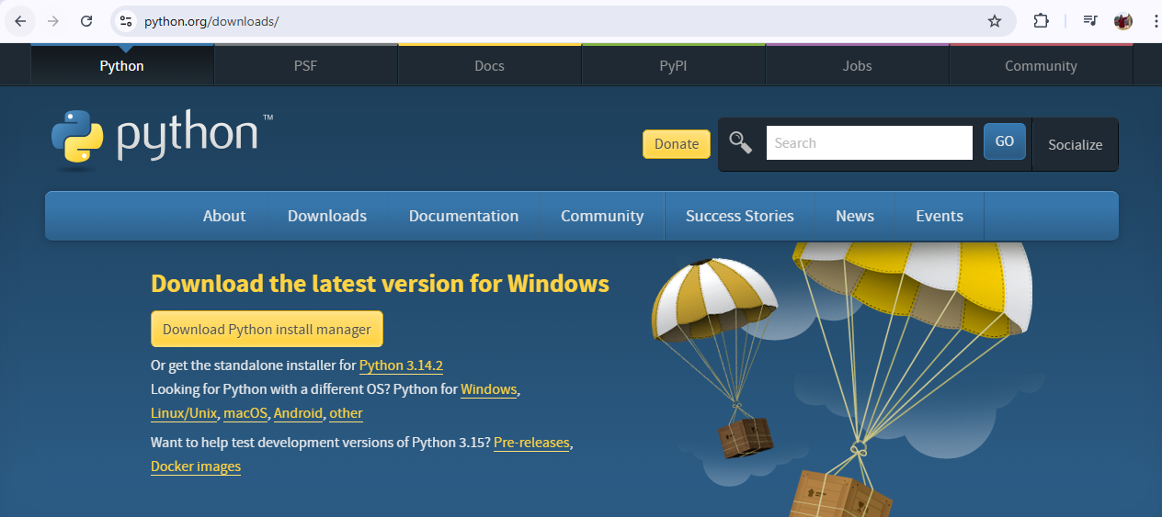
Installation and execution environment:
Follow these steps to set up the Python programming environment on your system:
1. Download Python
Visit the official Python website: www.python.org
Download the latest stable version of Python suitable for your operating system (Windows, macOS, or Linux).

Slide 12
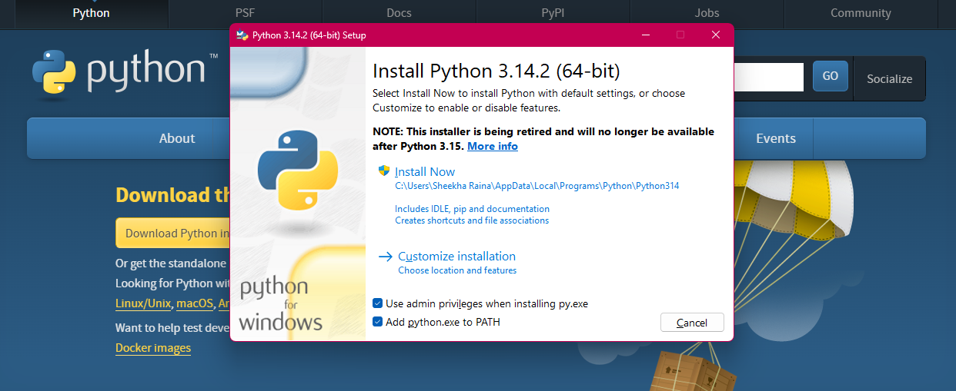
Python Environment Setup
2. Install Python
Run the installer file.
Important (Windows): Check the option “Add Python to PATH” before clicking Install Now.
Complete the installation by following the on-screen instructions.

Slide 13
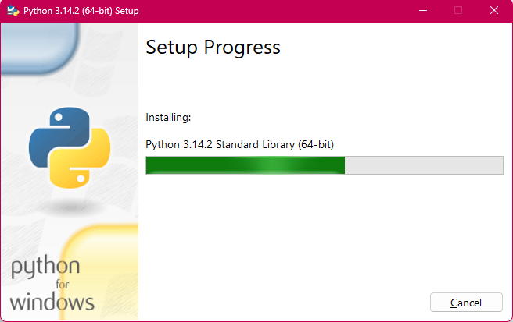
Python Environment Setup
After initiating the installation process, the setup window will appear as shown below.

Slide 14
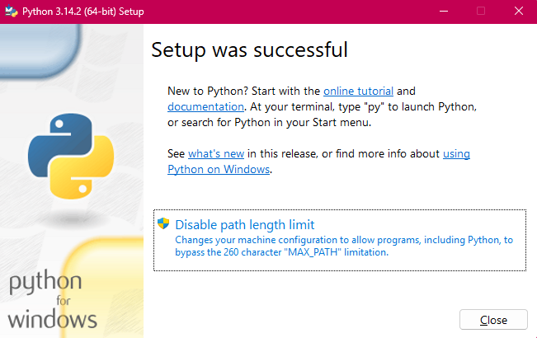
Python Environment Setup
After the successful completion of the setup process, the success window will appear as shown below.

Slide 15
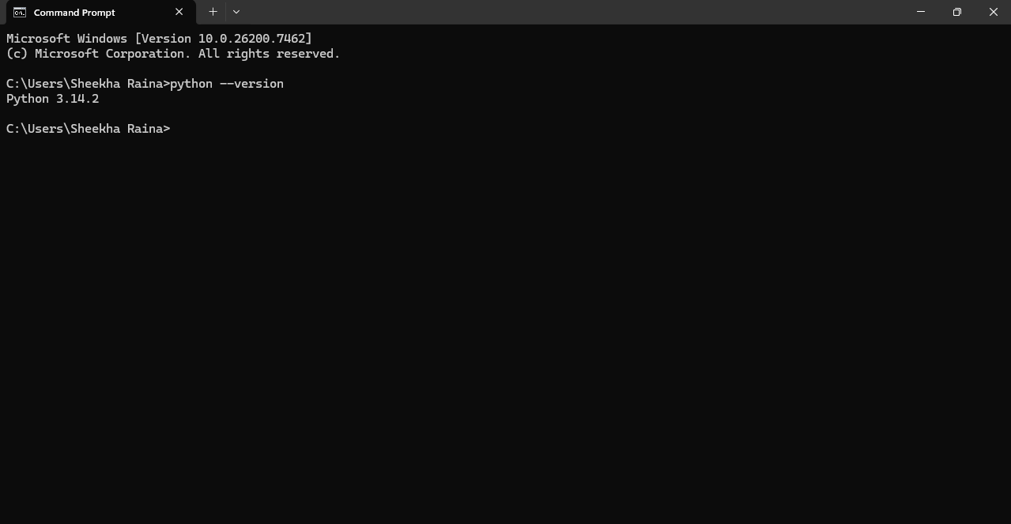
Python Environment Setup
3. Verify Installation
Open Command Prompt (Windows) or Terminal (macOS/Linux).
Type python --version or python3 --version and press Enter.
If Python is installed correctly, the installed version number will be displayed as shown below:

Slide 16
Python Environment Setup
4. Python Interpreter
Python runs using an interpreter, which executes code line by line.
You can start the interpreter by typing python in the command prompt or terminal.
5. Choose an IDE or Code Editor (Optional)
Commonly used IDEs/editors include:
Pycharm
IDLE
Visual Studio Code
Replit
Sublime Text
Spyder
PvDev
Jupyter
Thonny
PyScripter

Slide 17
Python Environment Setup
These tools make writing and running Python programs easier.
Python IDE- IDLE
IDLE (Integrated Development and Learning Environment) is a dedicated platform or software to develop Python applications. It is a full-fledged editor that is used to create, modify, and execute python code. It can also be used like the Python Shell to execute single statements. Python IDLE would be of great help, especially to beginners.
IDLE is open-sourced and available free of charge.
Key Features
Interactive Shell: IDLE’s interactive shell allows you to execute Python code one statement at a time, making it a great learning tool.
Simple Debugger: Provides basic debugging capabilities such as stepping through code and inspecting variables.
Auto-Completion: A basic auto-completion feature helps you avoid syntax errors as you write.

Slide 18
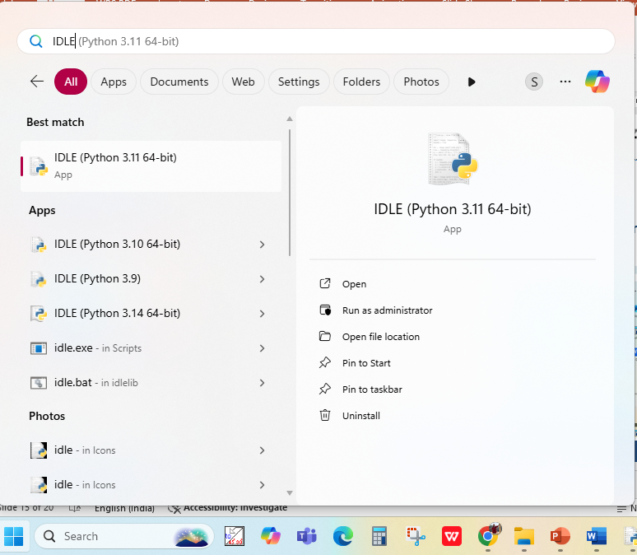
Python Environment Setup
Steps to open IDLE environment:
1. Click on the Start button and search for the IDLE application that is already installed. (Refer to slide no. 7 to 12)

Slide 19

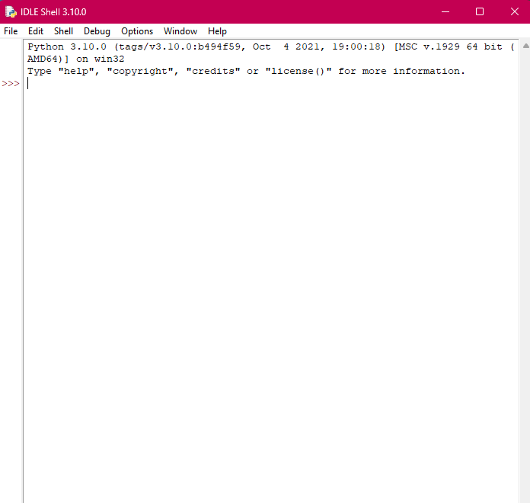
Python Environment Setup
Steps to open IDLE environment:
2. Click on this application
3. The following Shell window will appear:

Slide 20
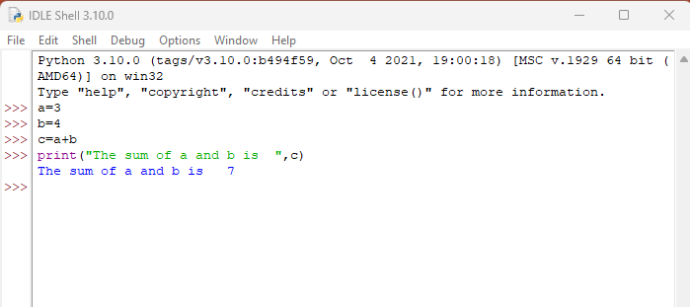
Python Environment Setup
Steps to open IDLE environment:
3. The window displays the execution of a program to sum two numbers. This Python shell window is known as Interactive Mode.

Slide 21
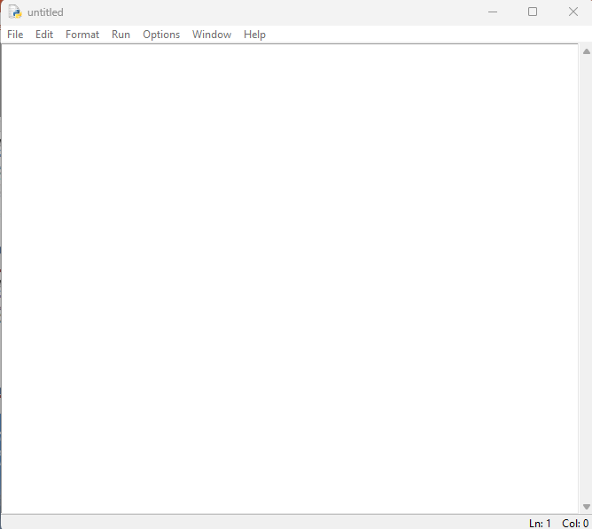
Python Environment Setup
1. In the Interactive mode, click the File>New File, untitled window will open as shown below: It refers to as the script mode.

Slide 22
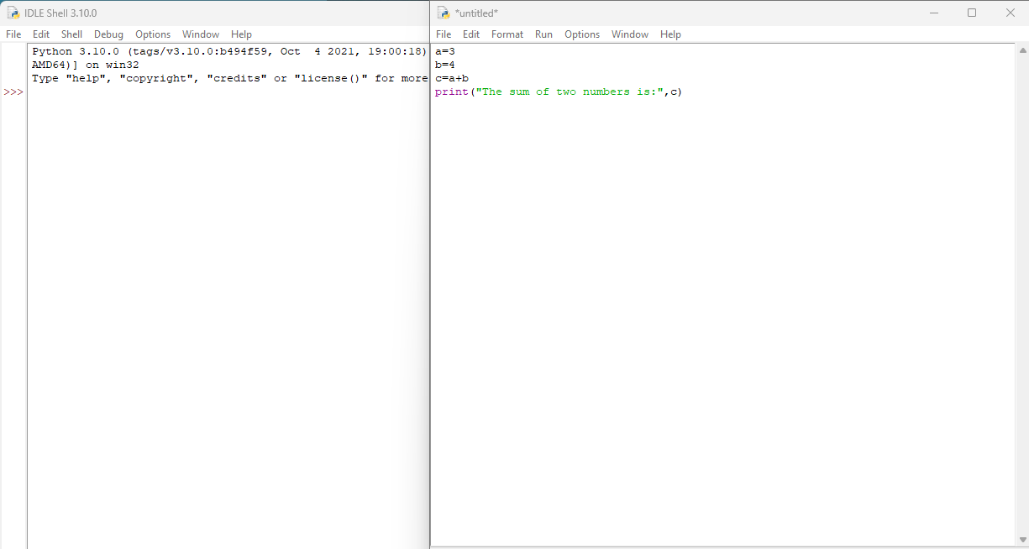
Python Environment Setup
Write the program to do the addition of two numbers. Click on Run>Run Module to execute the code.

Slide 23
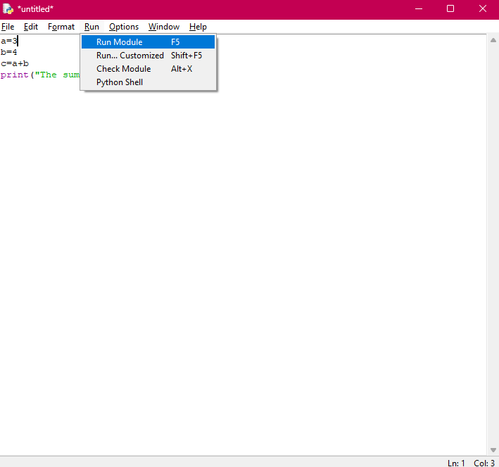
Python Environment Setup

Slide 24
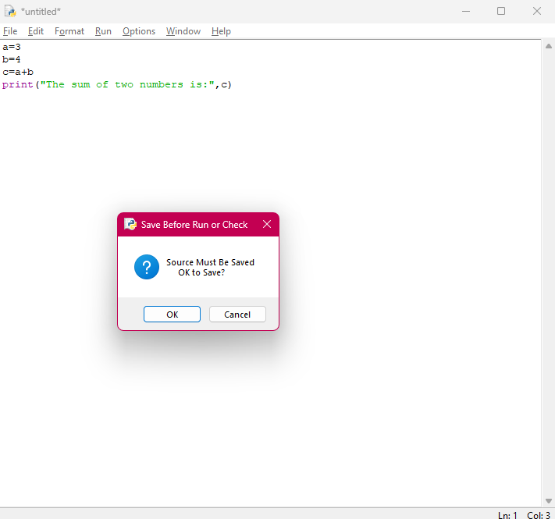
Python Environment Setup
When we click on Run Module, the following dialog box will appear as shown below:

Slide 25
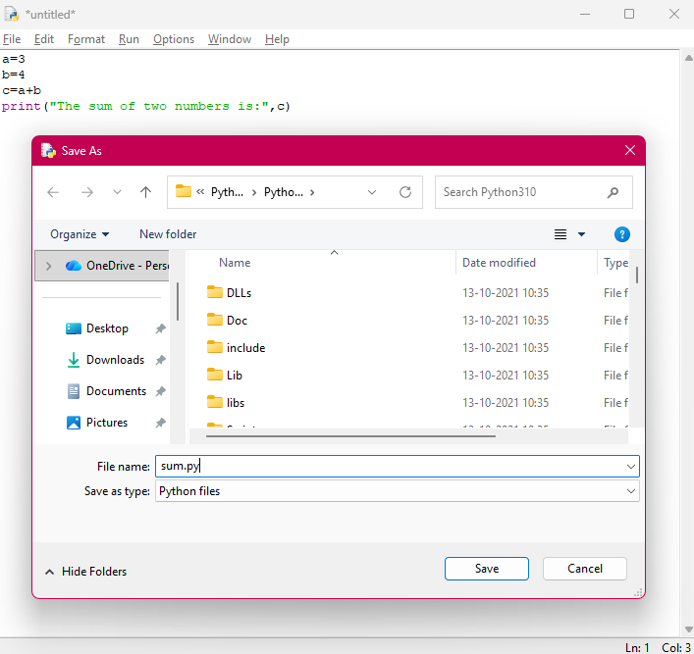
Python Environment Setup
Click on the Ok button. The following dialog box will appear as shown below:
Give the file name with .py extension i.e. optional and click on Save button.

Slide 26
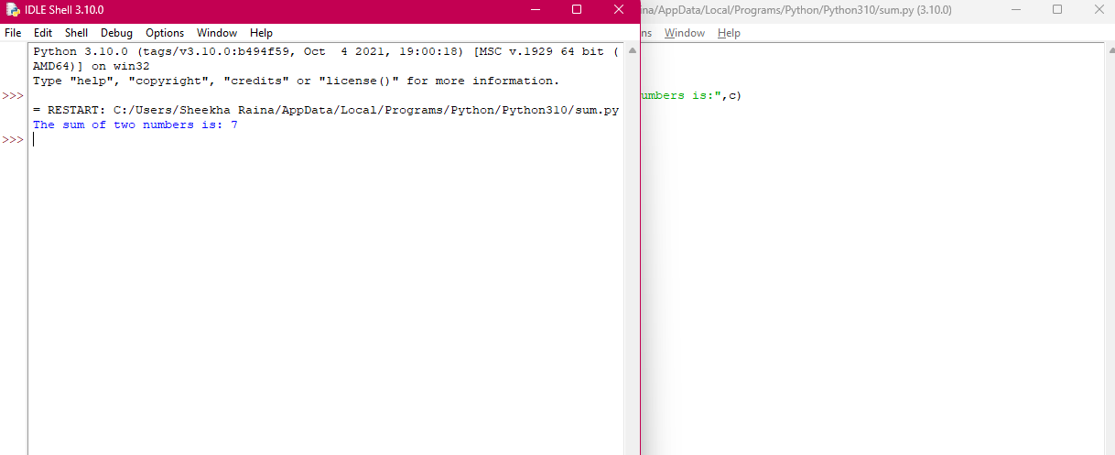
Python Environment Setup
The output will be displayed in an interactive mode as shown below: This way we can write a program in an interactive mode and script mode.

Slide 27
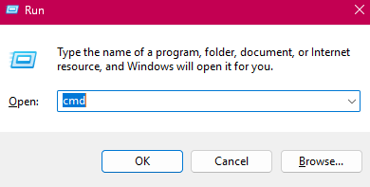
Python Environment Setup
Step-by-step methods to open Python from the Command Prompt (CMD) on Windows operating system:
Press Win + R, the Run dialog box will open.
Type cmd and press Enter.

Slide 28
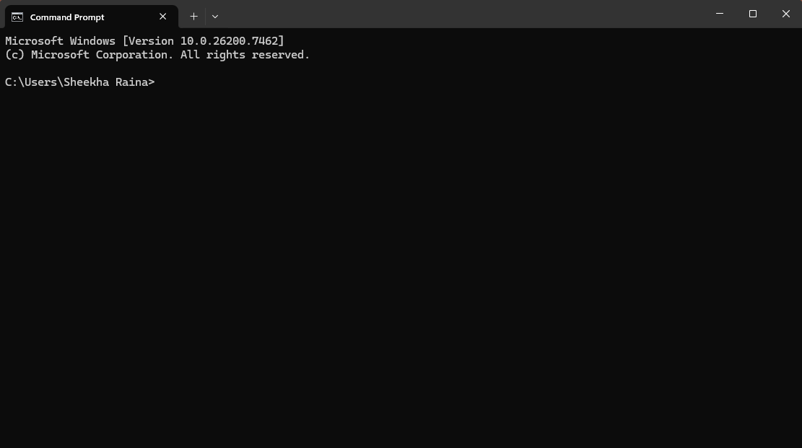
Python Environment Setup
The command prompt window will open as shown below:

Slide 29
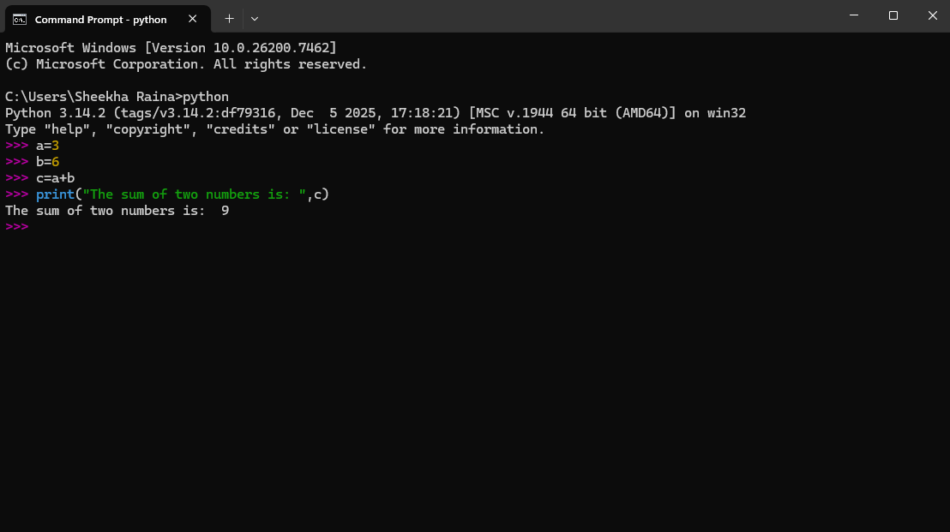
Python Environment Setup
In the Command Prompt, type: python
Press enter.
The python prompt will be displayed. Now you can perform the addition of two numbers as shown below:

Slide 30
Python syntax and semantics
Python syntax is like grammar for this programming language. Syntax refers to the set of rules that defines how to write and organize code so that the Python interpreter can understand and run it correctly. These rules ensure that your code is structured, formatted, and error-free. Here are some basic Python syntax:
Indentation in Python
Python Indentation refers to the use of whitespace (spaces or tabs) at the beginning of code line. It is used to define the code blocks. Indentation is crucial in Python because, unlike many other programming languages that use braces "{}" to define blocks, Python uses indentation. It improves the readability of Python code, but on other hand it became difficult to rectify indentation errors. Even one extra or less space can leads to indentation error. E.g.
if 10 > 5:
print("This is true!")
print("I am tab indentation")
print("I have no indentation")

Slide 31
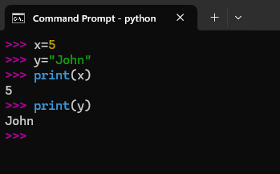
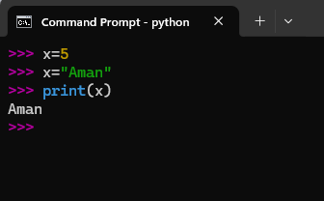
Variables in Python
Variables are used to store data values. In Python, there is no need to declare a variable explicitly. A variable is created automatically when a value is assigned to it.
In Python, variables do not have a fixed data type. The type is assigned automatically and can change later in the program.

Slide 32
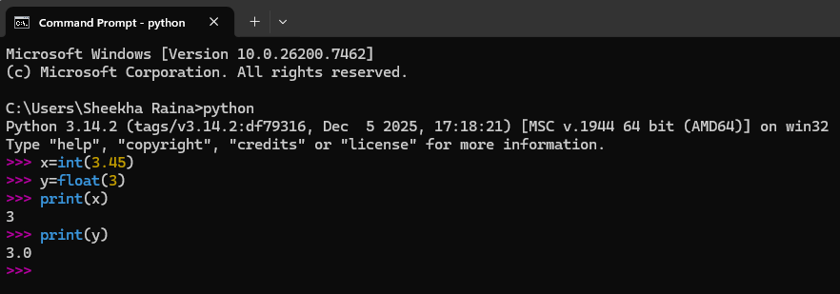
Type Casting:
Type Casting in Python refers to the process of converting a variable from one data type to another in order to specify its data type.

Slide 33
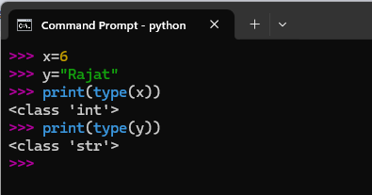
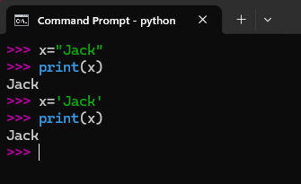
How to get the type of a variable?
You can find the data type of a variable by using the type() function.
Usage of Single or Double Quotes with variables?

Slide 34
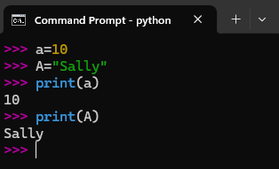
Variables are case sensitive
Variable names in Python are case-sensitive; for example, count and Count are treated as different variables.

Slide 35
Identifiers in Python:
Identifiers are the names used to identify variables, functions, classes, modules, or other objects in Python.
Rules for Identifiers in Python:
An identifier must start with a letter (a–z or A–Z) or an underscore (_).
It cannot start with a digit.
Identifiers can contain letters, digits, and underscores only.
Special characters like @, #, $, % are not allowed.
Keywords (such as if, for, while, class, etc.) cannot be used as identifiers.
Identifiers are case-sensitive (total, Total, and TOTAL are different).
Identifiers can be of any length.

Slide 36
Identify valid and Not Valid Identifiers
user_name
totalCount
1stName
my-var
_internal_value
myvar2
total score
name@web
calculate_sum
99
def
for

Slide 37
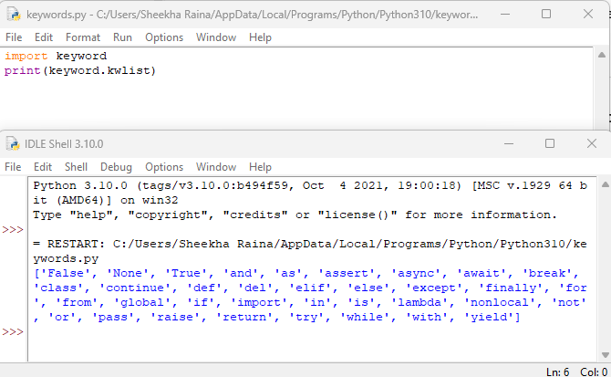
Keywords in Python:
Keywords in Python are reserved words that have predefined meanings and cannot be used as identifiers.
How to verify keywords in Python?

Slide 38
Line 1: import keyword
This imports the built-in keyword module in Python.
The keyword module provides information about Python’s reserved keywords.
Line 2: print(keyword.kwlist)
kwlist is a predefined list inside the keyword module.
It contains all the Python keywords of the currently installed Python version.
print() displays this list on the screen.

Slide 39
Comments in Python
Comments in Python are statements written within the code. They are meant to explain, clarify, or give context about specific parts of the code. The purpose of comments is to explain the working of a code, they have no impact on the execution or outcome of a program.
Single Line Comment
Single line comments are preceded by the "#" symbol. Everything after this symbol on the same line is considered a comment.
For Example:
first_name = "Reddy"
last_name = "Anna" # assign last name
# print full name
print(first_name, last_name)
Output
Reddy Anna

Slide 40
Multi-line Comment
Python doesn't have a specific syntax for multi-line comments. However, programmers often use multiple single-line comments, one after the other, or sometimes triple quotes (either ''' or """), even though they're technically string literals. Below is the example of multiline comment.
'''
Multi Line comment.
Code will print name.
'''
f_name = "Alen"
print(f_name)

Slide 41
Continuation of Statements in Python
In Python, statements are typically written on a single line. However, there are scenarios where writing a statement on multiple lines can improve readability or is required due to the length of the statement. This continuation of statements over multiple lines is supported in Python in various ways:
Implicit Continuation
Python implicitly supports line continuation within parentheses (), square brackets [], and curly braces {}. This is often used in defining multi-line lists, tuples, dictionaries, or function arguments.
# Line continuation within square brackets '[]'
numbers = [
1, 2, 3,
4, 5, 6,
7, 8, 9
]
print(numbers)

Slide 42
Explicit Continuation
You can use backslash '\' to indicate that a statement should continue on the next line.
# Explicit continuation
s = "GFG is computer science portal " \
"by Geeks, used by Geeks."
print(s)
Note: Using a backslash does have some pitfalls, such as if there's a space after the backslash, it will result in a syntax error.

Slide 43
Input and Output Function:
Understanding input and output operations is fundamental to Python programming. With the print() function, we can display output in various formats, while the input() function enables interaction with users by gathering input during program execution.
Taking input in Python
Python's input() function is used to take user input. By default, it returns the user input in form of a string.
Example:
name = input("Enter your name: ")
print("Hello,", name, "! Welcome!")
Output
Enter your name: GeeksforGeeks Hello, GeeksforGeeks ! Welcome!

Slide 44
Printing Output using print() in Python:
Print() function allows us to display text, variables and expressions on the console. Let's begin with the basic usage of the print() function:
In this example, "Hello, World!" is a string literal enclosed within double quotes. When executed, this statement will output the text to the console.
print("Hello, World!")
Output
Hello, World!

Slide 45
Data Types in Python:
Data types specify the type of data that a variable can store. Python is a dynamically typed language, so the data type of a variable is determined at runtime.

Slide 46
By default, Python has various built-in data types organized under the following categories.
Text Type: | str
Numeric Types: | int, float, complex (2+3j)
Sequence Types: | list, tuple, range
Mapping Type: | dict
Set Types: | set, frozenset
Boolean Type: | bool
Binary Types: | bytes, bytearray, memoryview
None Type: | NoneType

Slide 47
List : A list is an ordered and mutable (changeable) collection of elements.
Features:
Allows duplicate values
Elements can be of different data types
Indexing is supported
Example
numbers = [10, 20, 30, 40]
numbers[1] = 25
print(numbers)
Output: [10, 25, 30, 40]

Slide 48
A tuple is an ordered but immutable (unchangeable) collection.
Features:
Faster than lists
Allows duplicate values
Cannot be modified after creation
Example
points = (1, 2, 3)
print(points)
Output: (1, 2, 3)

Slide 49
The range data type is used to generate a sequence of numbers.
It is commonly used in loops, especially for loops.
range(stop)
Starts from 0 and goes up to stop - 1.
E.g.
r = range(5)
print(list(r))
Output: [0, 1, 2, 3, 4]

Slide 50
A dictionary (dict) is a data type used to store data in key–value pairs. Each key is used to access its corresponding value.
Features:
Unordered (ordered from Python 3.7+)
Keys must be unique
Mutable
Example
student = {"name": "Alice", "age": 20}
print(student["name"])
student → dictionary variable
"name" and "age" → keys
"Alice" and 20 → values
student["name"] → accesses the value of key "name"

Slide 51
A set is an unordered collection of unique elements.
Features:
No duplicate values
Mutable
No indexing
Example
s = {1, 2, 3, 3}
print(s)
Output: {1, 2, 3}

Slide 52
Bytes, Bytearray, and Memoryview
These data types are used to handle binary data, such as images, files, and network data.
Bytes (bytes)bytes is an immutable sequence of bytes (values from 0 to 255).
bytearray is a mutable sequence of bytes.
memoryview allows access to the memory of bytes or bytearray without copying data.

Slide 53
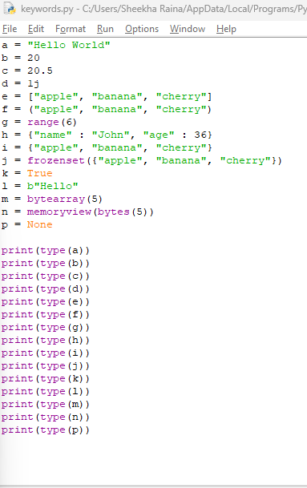
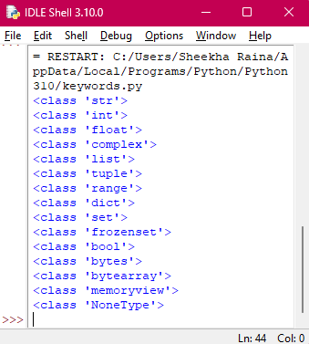
Example:

Slide 54
Python Operators:
Python operators are special symbols or keywords used to perform operations on variables and values.
Python divides the operators in the following groups:
Arithmetic operators
Assignment operators
Comparison operators
Logical operators
Identity operators
Membership operators
Bitwise operators

Slide 55
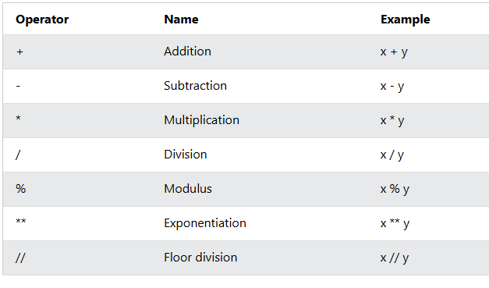
Python Operators:
Arithmetic operators: Arithmetic operators are used with numeric values to perform common mathematical operations:

Slide 56
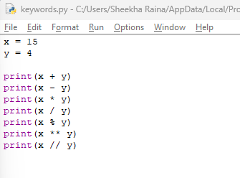
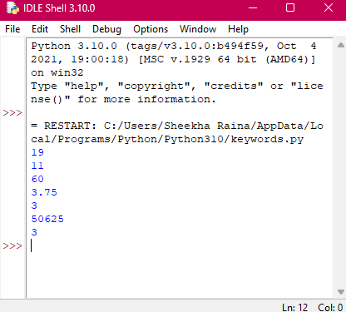
Example of Arithmetic operators

Slide 57
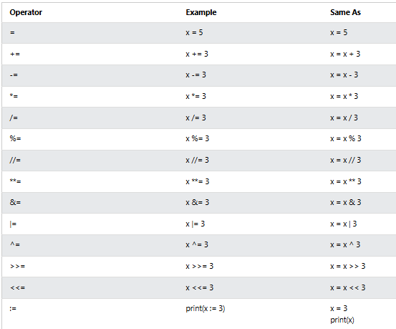
2. Assignment Operators: Assignment operators are used to assign values to variables and, in some cases, perform an operation and assign the result to the same variable.

Slide 58
Example:

Slide 59
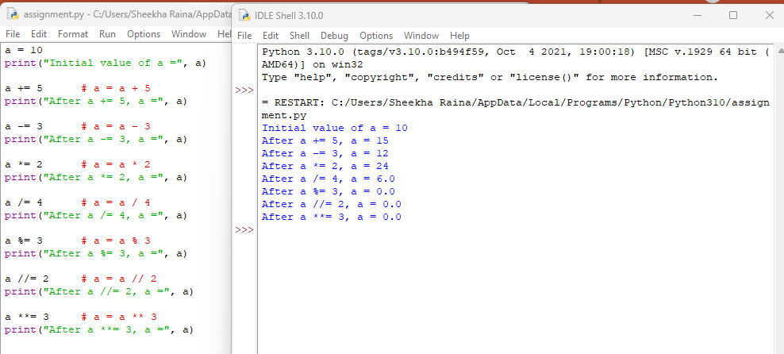
Example of Assignment Operators:

Slide 60
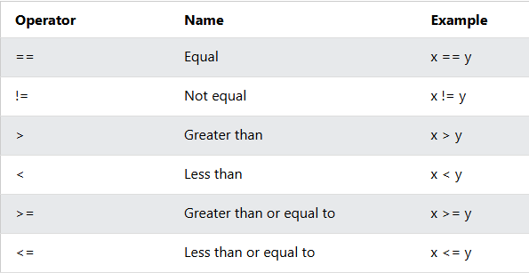
3. Comparison Operators
Comparison operators are used to compare two values. They return True or False based on the comparison result.

Slide 61
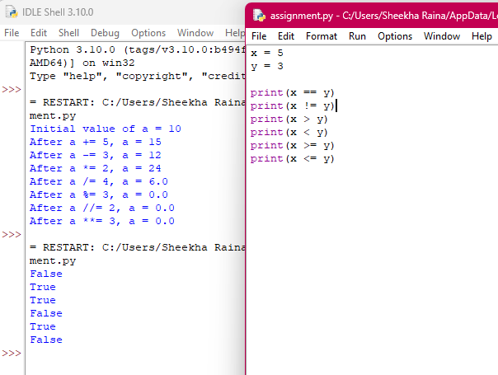
Example of Comparison Operators:

Slide 62
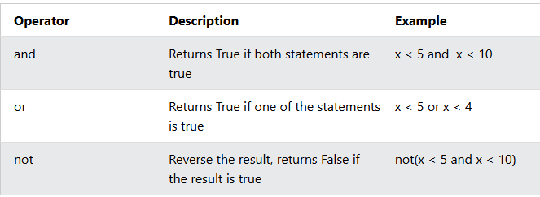
4. Logical Operators: Logical operators are used to combine conditional statements and return a Boolean value (True or False).

Slide 63
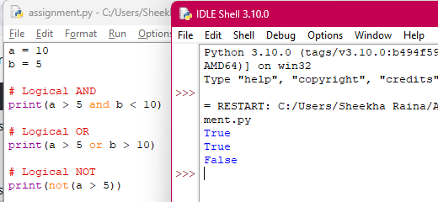
Example of Logical Operators:

Slide 64
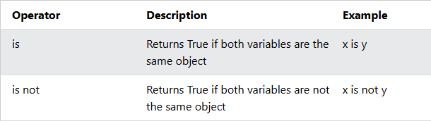
5. Identity Operators: These operators are used to compare objects, not whether they have the same value, but whether they refer to the same object in memory (same memory location)

Slide 65
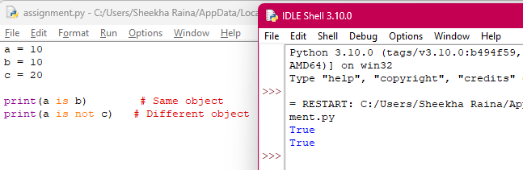
Example of Identity Operators:

Slide 66
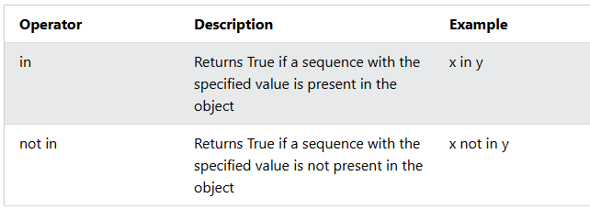
6. Membership Operators: These operators are used to test whether a value is present in a sequence or not. They return True or False.

Slide 67
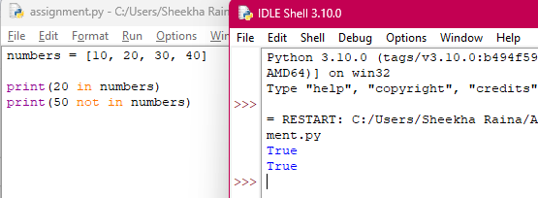
Example of Membership Operators:

Slide 68
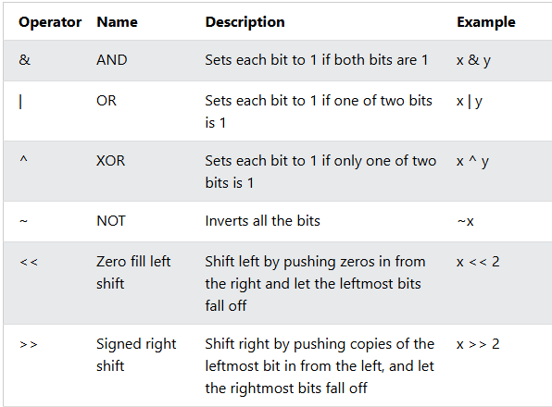
7. Bitwise Operators: Bitwise operators are used to perform operations on numbers at the binary (bit-by-bit) level. They work directly on the binary representation of integers.

Slide 69
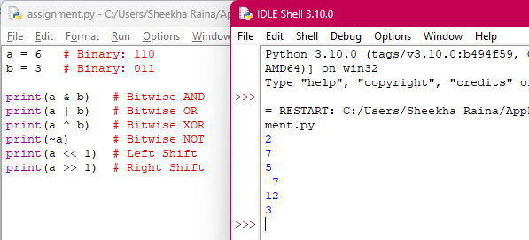
Example of Bitwise Operators:

Slide 70
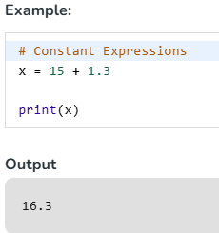
Expressions in Python:
An expression is a combination of operators and operands that is interpreted to produce some other value. In any programming language, an expression is evaluated as per the precedence of its operators. So that if there is more than one operator in an expression, their precedence decides which operation will be performed first. We have many different types of expressions in Python. Let's discuss all types along with some exemplar codes :
1. Constant Expressions: These are the expressions that have constant values only.

Slide 71
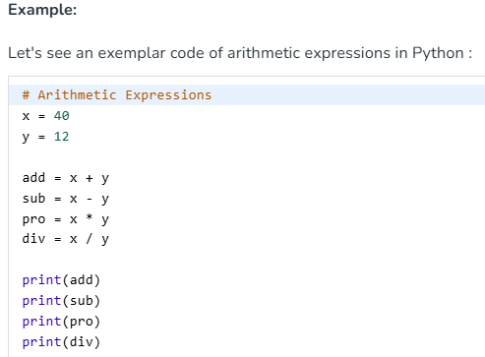
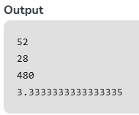
2. Arithmetic Expressions: An arithmetic expression is a combination of numeric values, operators, and sometimes parenthesis. The result of this type of expression is also a numeric value.

Slide 72
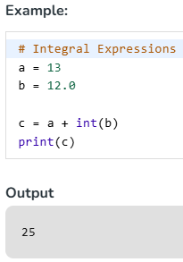
3. Integral Expressions: These are the kind of expressions that produce only integer results after all computations and type conversions.

Slide 73
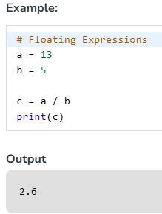
4. Floating Expressions: These are the kind of expressions which produce floating point numbers as result after all computations and type conversions.

Slide 74
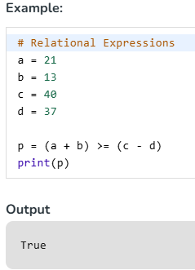
5. Relational Expressions: In these types of expressions, arithmetic expressions are written on both sides of relational operator (> , < , >= , <=). Those arithmetic expressions are evaluated first, and then compared as per relational operator and produce a boolean output in the end. These expressions are also called Boolean expressions.

Slide 75
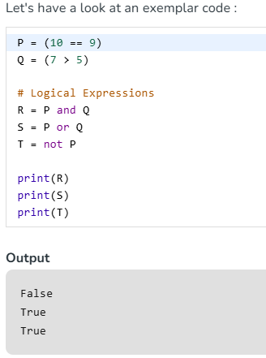
6. Logical Expressions: These are kinds of expressions that result in either True or False. It basically specifies one or more conditions

Slide 76
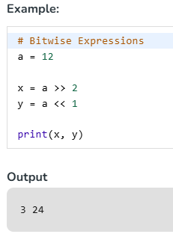
7. Bitwise Expressions: These are the kind of expressions in which computations are performed at bit level.

Slide 77
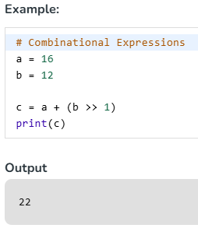
8. Combinational Expressions: We can also use different types of expressions in a single expression, and that will be termed as combinational expressions.

Slide 78

Operator Precedence
Operator precedence
describes the order in
which operations are
performed.

Slide 79


Operator Precedence

